Slide 1
Presentation
Item 6.2b
Summary Financial Report
as at 31st March 2023 (Month 12)
Draft- 2022/23 Year Position

Slide 2
2022/23 Financial Position
Key Points-Year End Position (Prior to External Audit)
Achievement of Board approved 2022/23 break even Financial Plan £39k surplus disclosed at Month 12 Over delivery on Income of £2.598m has offset the overspend on expenditure of £2.559m – £39k net positive variance £3.011m (FYE) of efficiencies have been identified at Month 12 Delivery of Non-Core break even position Core Capital planning level exceeded with additional SG funding agreed

Slide 3
2022/23 Financial Position
Key – Income / Expenditure variances- improved position against budget are +ve

Slide 4
2022/23 Financial Position
Key Income Points at March 2023

Slide 5
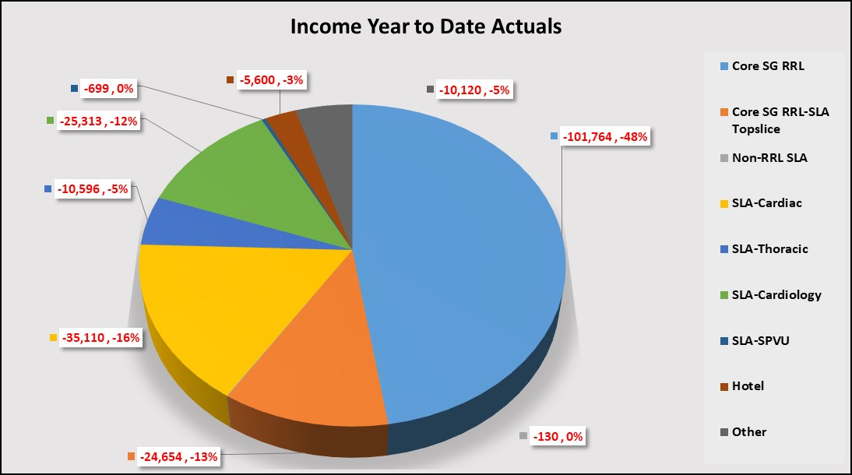
2022/23 Financial Position
Key Income Points at March 2023

Slide 6
2022/23 Financial Position
Key Income Points at March 2023
Core Funding received of £132.973m, with final allocations due in M13 of (£6.555m) – adjustment of Core to Non-core for Depreciation
Final Anticipated Core RRL of £126.418m
Other Income of £87.568m equating to an over-recovery against final budget of £84.970m by £2.598m
  Total SLAs £296k
  Hotel income £1,713k
  Other variances £589k

Slide 7
2022/23 Financial Position
Key Expenditure Points at March 2023
 | Annual Budget | Year To Date Budget | Year to Date Actuals | Variance | Variance %
Staff Costs-Medical | 35,788 | 35,788 | 36,888 | -1,100 | -3.1%
Staff Costs-Nursing | 46,011 | 46,011 | 44,207 | 1,804 | 3.9%
Staff Costs-Clinical | 18,594 | 18,594 | 17,870 | 724 | 3.9%
Staff Costs-Support | 11,161 | 11,161 | 10,943 | 218 | 2.0%
Staff Costs-Admin | 23,371 | 23,371 | 23,630 | -259 | -1.1%
Total Pay Expenditure | 134,925 | 134,925 | 133,538 | 1,387 | 1.0%
Pharmacy Supplies | 4,519 | 4,519 | 4,905 | -386 | -8.5%
Surgical Supplies | 28,932 | 28,932 | 31,563 | -2,631 | -9.1%
Lab/Radiology Supplies | 1,857 | 1,857 | 2,017 | -160 | -8.6%
PPE | 9,113 | 9,113 | 10,332 | -1,219 | -13.4%
FM | 8,171 | 8,171 | 8,828 | -657 | -8.0%
CS&R&S | 23,870 | 23,870 | 22,763 | 1,107 | 4.6%
Total Core Expenditure | 76,462 | 76,462 | 80,408 | -3,946 | -5.2%
Total Expenditure | 211,387 | 211,387 | 213,946 | -2,559 | -1.2%
All figures £000's

Slide 8
2022/23 Financial Position
Key Expenditure Points at March 2023
Overall overspend of (£2,559k)
  Pay Costs £1,387k favourable (c. 1% of YTD Budget)
    Medical Pay (£1,100k) over
    Nursing £1,804k under
    Clinical, Support, Admin £683k under
  Non Pay Costs (£3,945k) adverse (c.-5.2% of YTD Budget)
    Surgical Supplies (£2,631) k over
    Reserves £1,107k under
    Pharmacy, Radiology, PPE and FM £120k (£2,422)k over

Slide 9
2022/23 Financial Position
Key Expenditure Points-Divisions at March 2023
Pharmacy Supplies | -387 | -266 | -96 | -25 | 0
Surgical Supplies | -2,631 | -1,289 | -1,274 | -68 | 0
Lab/Radiology Supplies | -159 | -111 | -23 | -25 | 0
PPE | -1,219 | -333 | -30 | -463 | -393
FM | -657 | -144 | -97 | -267 | -149
CS&R&S | 1,109 | -41 | -333 | 1,446 | 37
Total Core Expenditure | -3,944 | -2,184 | -1,853 | 598 | -505
Total Expenditure | -2,558 | -2,011 | -641 | 1,054 | -960

Slide 10
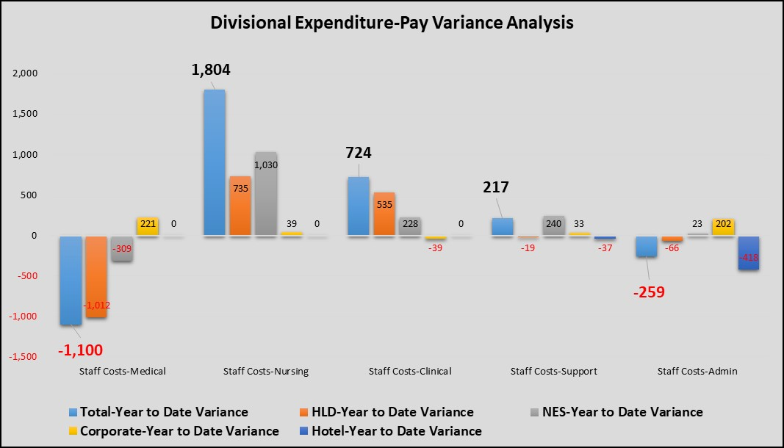
2022/23 Financial Position
Key Expenditure Points-Divisions at March 2023

Slide 11
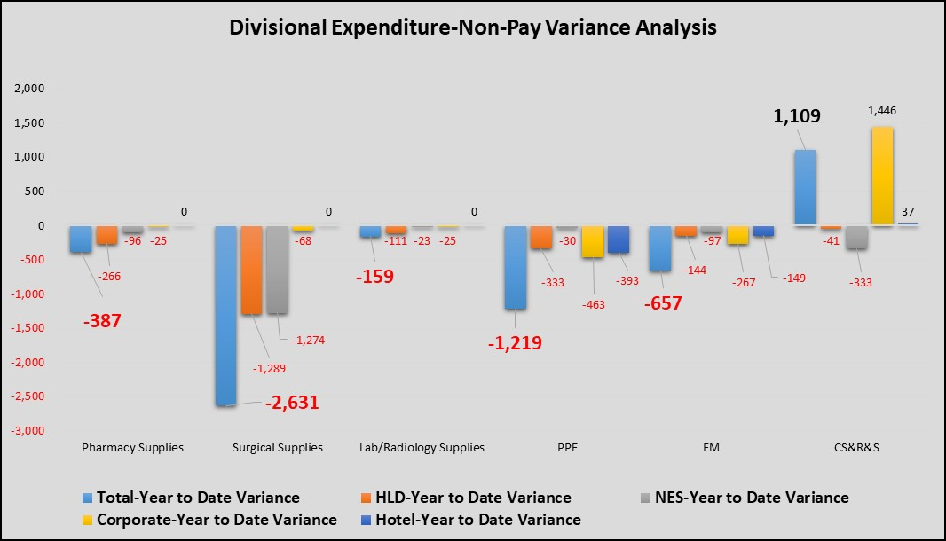
2022/23 Financial Position
Key Expenditure Points-Divisions at March 2023

Slide 12
2022/23 Financial Position
Efficiencies Update at March 2023
Financial Plan assumes £4.590m of in-year efficiency savings
  £3.011m of efficiencies have been identified at Month 12
  Current Balance of £1.579m offset with general income over performance
  and reserve position
Workforce
Procurement
Digital/ Technology
CfSD
Quality Improvement
Estates/ Capital
NHS Academy

Slide 13
2022/23 Financial Position
Efficiencies Update at March 2023

Slide 14
2022/23 Financial Position
Draft Breakeven Outturn – Key Risks and Current Assumptions
2022/23 Financial Plan – Non-Core expenditure was not included in Board Draft
Unbudgeted/ unknown expenditure items at year end e.g. National Financial
Ledger issues
Movements in costs and income not shown through trend analysis
Scottish Government remaining anticipated allocations will be received M13
SLAs- Income Risks and volume levels were achieved

Slide 15
2022/23 Financial Position
Other considerations of the Summary Financial Report at March 2023
Non-Core position – Break-even
  This area covers depreciation charges, annual managed expenditure items and any impairment of assets.
Capital
  The core capital plan was exceed with £11.785m of expenditure
  Phase 2 expected expenditure is currently being discussed with SG. Current estimate £21.543m expected to be final figure

Slide 16
ELT Presentation
ELT are asked to :
1. Note the financial position for Month 12 subject to
External Audit
2. Note the key messages highlighted above
Questions ?

