Slide 1
Presentation
Item 6.2App2
Summary Financial Report
as at 31 July 2023 (Month 4)
NHS Golden Jubilee Board

Slide 2
2023/24 Financial Position
Key Points (Month 4)
Board approved a 2023/24 break even Financial Plan Financial Plan requires c.(£6.66m) of budget savings /in-year efficiencies by March 2024 June 2023 position is the third report presented within FY 2023/23 Scottish Government FPR return submitted at Month 3 Further work is being completed by Finance in advance of Month 5 e.g. allocating further central budgets, revising reporting structures and specific work on HLD Division

Slide 3
2023/24 Financial Position
The net revenue core position for July 2023 reflects an overall adverse variance of £ (0.407m).
Income to date of £71.143m is ahead of the year to date budget of £70.421m resulting in a positive variance of £0.722m.
Expenditure to date of £71.550m is ahead of the year to date budget of £70.421m resulting in an adverse variance of £ (1.129) m.

Slide 4
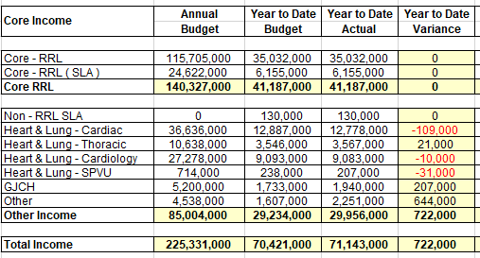
2023/24 Financial Position
Key Income Points at July 2023

Slide 5
2023/24 Financial Position
Key Income Points at July 2023
Core Funding allocated to date of £41.187m
Anticipated total Core RRL of £140.327m for 2023/24
Other Income of £29.956m equating to an over-recovery against budget of £29.234m by £722k
Total SLAs £(129)
Hotel income £207k
Other variances £644k (VAT rebate £244k and SNRSS £311k)

Slide 6
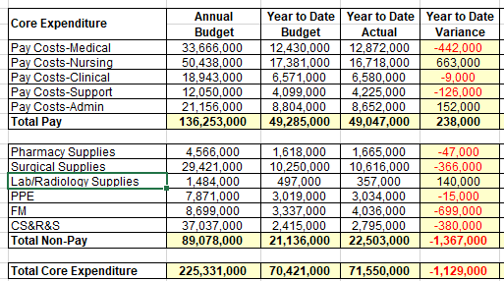
2023/24 Financial Position
Key Expenditure Points at July 2023

Slide 7
2023/24 Financial Position
Key Expenditure Points at July 2023
Overall overspend of £(1.129m)
Pay Costs £238k favourable (c.<0.5% of YTD Budget)
Non Pay Costs (£1.367m) adverse (c.-6.5% of YTD Budget)
Medical Staff | £(442k) | Over
Nursing Staff | 663k | Under
Clinical, Support & Admin | 17k | Under
Pharmacy Supplies | £(47k) | Over
Surgical Supplies | £(366k) | Over
Lab/Radiology | £140k | Under
PPE | £(15k) | Over
FM | £(699k) | Over
CS&R&S | £(380k) | Over

Slide 8
2023/24 Financial Position
Key Expenditure Points at July 2023
Surgical Supplies (£366k) YTD
Surgical Supplies are a complex area for the Board and better data, systems and analysis are
required to allow a fuller ability to understand changes to these budget lines
FM (£699k) YTD
The main driver of FM is the increase in charges for Rates & Utilities and this is being
investigated by the Estates team who are liaising with our energy supplier directly to confirm
the accuracy of charges and consumption levels applied
CS&R&S (£380k) YTD
GJCH patient rooms (£79k), Consultancy costs within E-health of (£111k), postage
relating to increased patient activity (£43k) and Laboratory costs within Haematology in
HLD of (£57k)

Slide 9
2023/24 Financial Position
Efficiencies Update at July 2023
Financial Plan assumes c.£(6.66)m of budget savings / in-year efficiency savings
Non-recurring savings of c.£4.58m have been identified (vacancy factor applied of £3.813m and ‘slippage’ of £0.766m on funded initiatives)
At Month 4, £1.271m of vacancy factor savings have been delivered together with £0.766m of ‘slippage’ – total £2.037m
£(2.085)m of unidentified savings still to be identified by the year-end.
Work is currently on-going on the identification of further budget savings on a non-recurring basis

Slide 10
2023/24 Financial Position
Efficiencies Update at July 2023
Additional resources now agreed across Finance, Procurement, Programme Management, Quality Improvement and Services to drive forward our Sustainability
and Value Programme
Key areas of focus during 2023/24 (starting July 2023)
Digital transformation initiatives e.g. PECOS
NHS Golden Jubilee Conference Hotel
Other Trading income – Dining, Vending and Shop
HLD Division (including NSD services)
Research Institute

Slide 11
2023/24 Financial Position
Key Risks and Current Assumptions
July 2023 (Month 4) early in FY so no key trends analysis
Under delivery of the budget savings / in-year efficiency savings to break even
Actual income is below budgeted expectations
Actual expenditure is above budgeted levels
Unbudgeted/ unknown expenditure items not provided for in Financial Plan
Scottish Government anticipated allocations not yet confirmed
SLAs-Income risks and volume levels achieved

Slide 12
2022/23 Financial Position
Other considerations of the Summary Financial Report at July 2023
Non-Core Position – Anticipated break-even
This area covers depreciation charges, annual managed expenditure items and any impairment of assets
Capital Position
Confirmation - Core Capital funding of £2.691m
Expected Allocations
2022/23 Capital Allocation ‘returned’ £1.887m
Academy Capital £1.084m
Water Source Heat Pump £4.1m (subject to further discussions)
Phase 2 £23m

Slide 13
Presentation
Decision: NHS Golden Jubilee Board
(1) Approve the Summary Financial Report as at 31 July 2023 (Month 4)
Questions ?

